Slide 1
Octane’20 Review Presentation
Project : To find low cost vision system for paint
finish inspection.
Department : Engineering
Mentor : Sandeep Magdum Sir
BU-HR : Vijay Sonar Sir

Slide 2
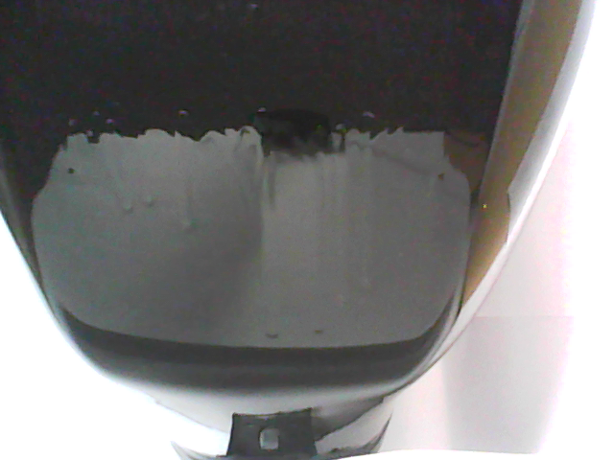
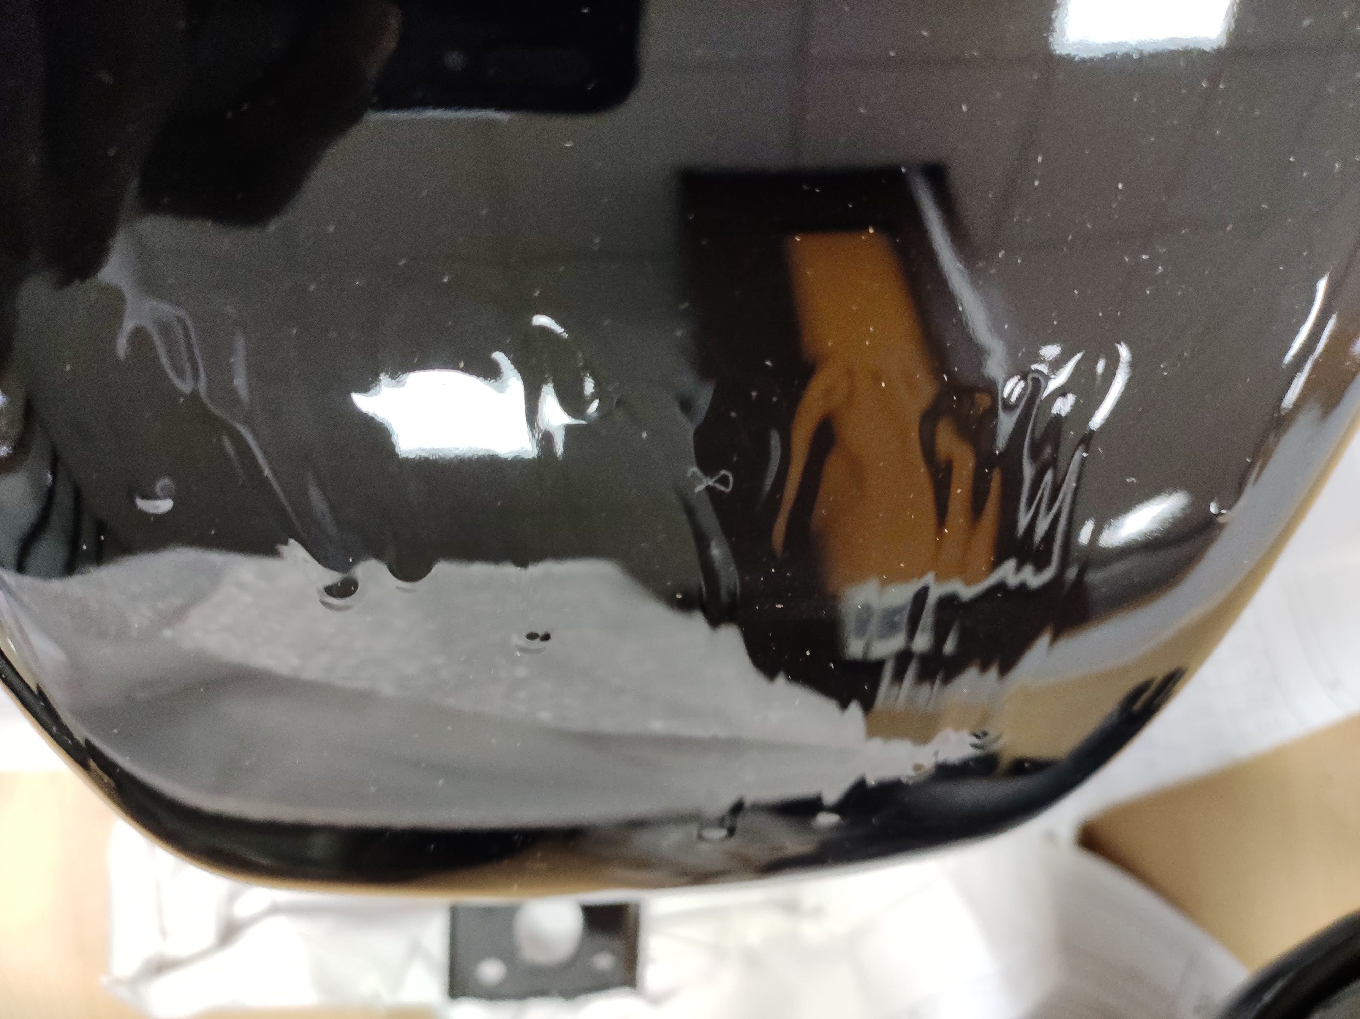
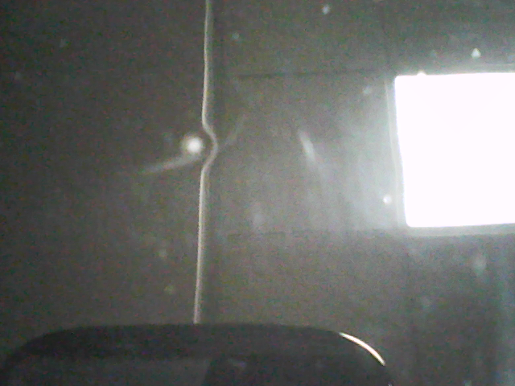
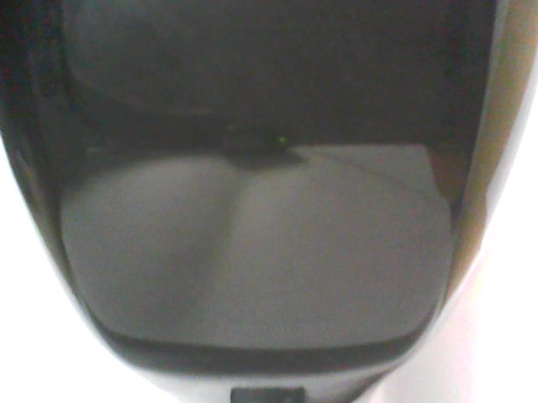
Paint defects and challenges
Identifying paint defects on petrol tank.
1. Runs
2. Dust
3. Craters
Runs Dust Crater OK
Challenges
Glare on specular curved surface hides paint defects.
Reflections on specular tank surface surfaces change pixel intensities of image.

Slide 3
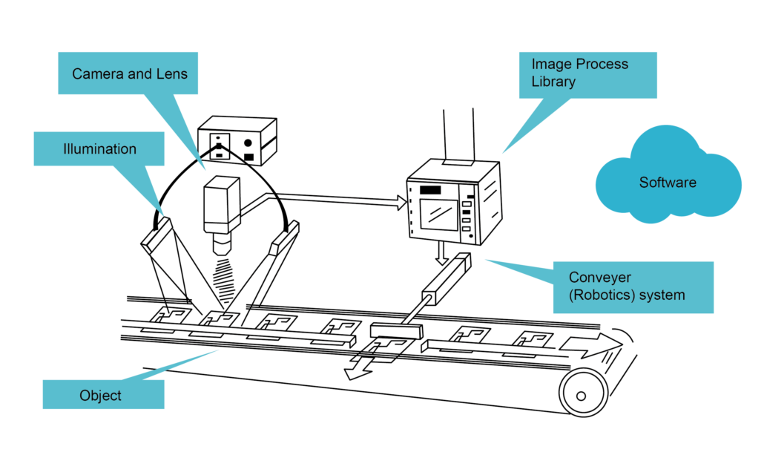
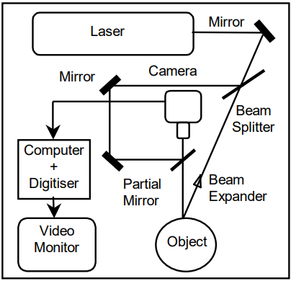
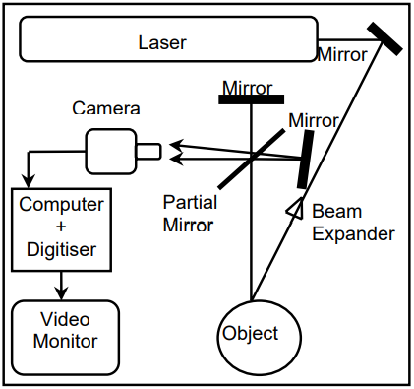
Defect inspection method
Inspection methods
Machine vision
Interferometry
Shearograpgy
Cost < 2 lakhs
Less components
Simple data analysis
Cost>7 lakhs
More components
Complex data analysis
Cost>7 lakhs
More components
Complex data analysis

Slide 4
Vision System for Paint finish inspection
Features of Vision System
High Accuracy
Low inference time
Cost effective
Simple Layout
Reliable
Inspection system
Visual representation of paint defect
Data collection by camera
Data transfer through a channel
Data processing unit
Defect classification
Paint defect
Camera and lighting
Interface
Edge computing
Image preprocessing
Image classification

Slide 5
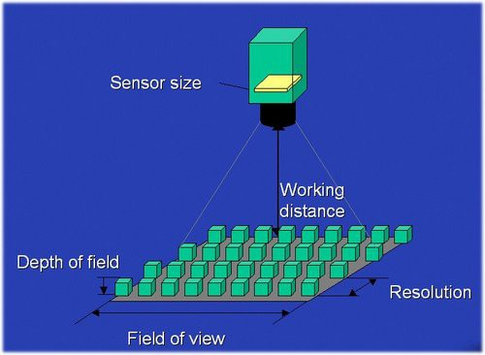
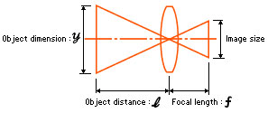
Camera
Pixel size & camera resolution
“At least 2 pixels must fit in an defect”
Work depth(WD)=500mm.
Field of view(FOV)=300mm
Focal length(FL)=16mm
FOV* FL=Sensor* WD
Pixel size=5 microns
Pixel size= Sensor/Resolution
Resolution>=6MP
Selected Resolution can easily find minimum size defect.
Defects like runs can be detected by 5MP resolution as well.
Defect | Dimension (micrometer)
Dust | 20
Pinhole | 50
Crater | 100
Solvent popping | 10-50

Slide 6
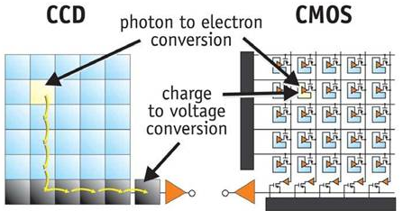
Camera
1.CMOS Sensor
Compact size.
High processing speed.
Consumes less power.
Glare resistant.
Better image resolution and field of view.
Global Shutter.
2. Interface
USB 3.0 is selected for low cost.
 | USB 3.0 | GigE
Bandwidth (Mbps) | 400 | 125
Camera Cost | Low | Low
Cable Cost | Low | Low
CPU Usage | Low | Medium
Multicamera Setup | Excellent | Good
Cable length | 4.6m | 100m

Slide 7
Low cost
Sensor
CMOS sensor has less cost than CCD sensor.
CMOS sensor is widely manufactured and offers more varieties.
Resolution
Right sizing of camera prevents over sizing of camera specifications.
Detailed study was done in camera resolution instead of going for higher resolution cameras like 21MP.
6MP resolution has been chosen with exactly matching our requirements.
Interface
USB 3.0 is least cost interface for higher bandwidth.

Slide 8
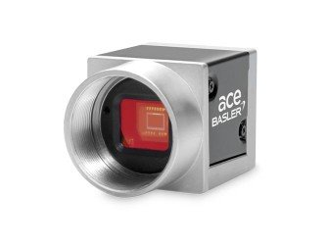
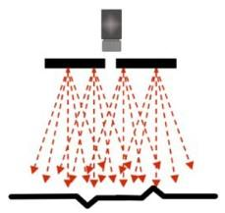
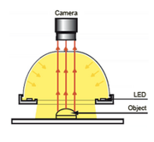
Camera and Lighting
Resolution: 6MP
Focal length: 16mm
Sensor size: 2/3”
Sensor: CMOS
USB 3.0
1.LED light is chosen as light source.
High life span
High efficiency
High CRI
2. Bright field illumination is the illumination technique
3. Dome light is chosen as light source geometry.
acA3088-57uc - Basler ace

Slide 9
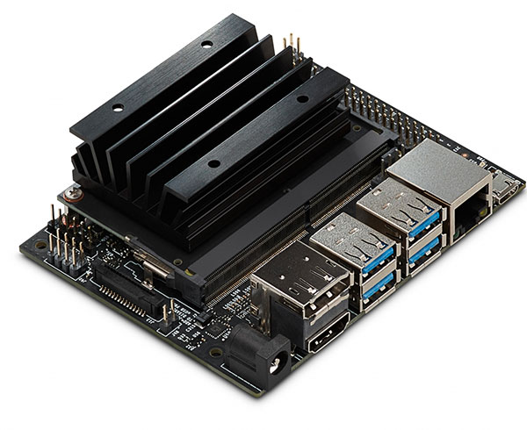
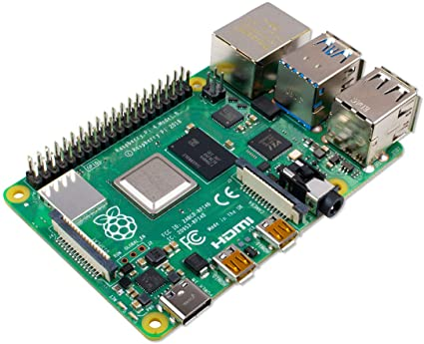
Edge computing
Edge Computing Solution
Placing computing device near to camera.
Decreases inference time and interface cost.
Enables real time service.
Device will perform Image preprocessing and classification.
Python code will be uploaded to the device.
Edge computing devices: Raspberry pi and Nvidia Jetson nano.
Key features
Latency
Scalability
Cost effective
Edge computing
Image preprocessing
Image classification

Slide 10
Low cost
Right sized processing device has been chosen for image processing.
Standard machine vision processing units come along with PC costing more.
Right sizing allows to reduce cost significantly.
Provided solution allows scalability at lower cost.
Low cost solution for multi camera setup.

Slide 11
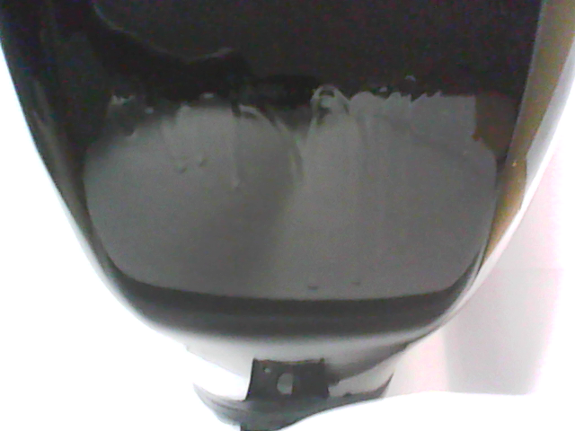
Defect Inspection
TEMPLATE MATCHING
Comparing all frames captured with image dataset.
Passing selected frames to classification algorithms.
Library: open-cv and matplotlib, Statistics
Template matching with sample image and calculating score
Frame
avg.score<threshold
No defect
avg.score>=threshold
Defect

Slide 12
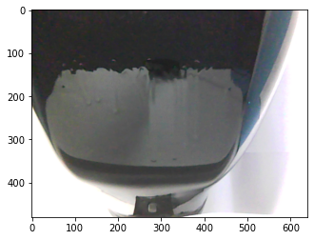
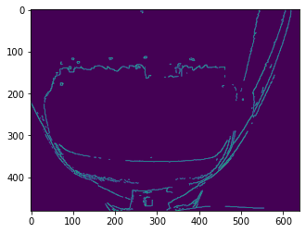
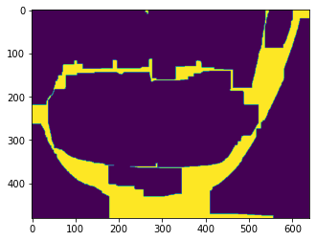
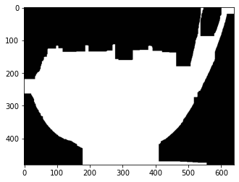
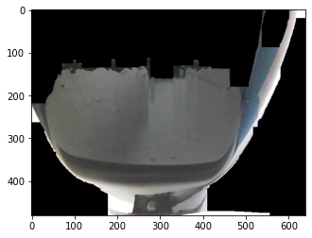
Image preprocessing
Defect image
Edge detection
Image morphing
Contour detection
Contour extraction
Masked image
Bitwise operation
Python Libraries
Open-cv
Skimage
Matplolib
Numpy
Reason
Preparing image for classification
Cost
All methods and algorithms are self developed.
Open source software.

Slide 13
Deep learning models for classification
Criteria for Selection
1. High accuracy
2. Low inference time
3. Low space requirement
Model Selection
Model with lowest inference time, space requirement with enough accuracy to classify our image.
Deep learning models for image classification
Squeeze Net, Resnet-18, MobileNetv2 and Shuffle Net have low inference time and low space.
Resnet-18 and MobileNetv2 have good accuracy for our application.
Both models can be easily deployed on raspberry pi and Nvidia Jetson Nano.

Slide 14

Convolution neural network(CNN)

Slide 15
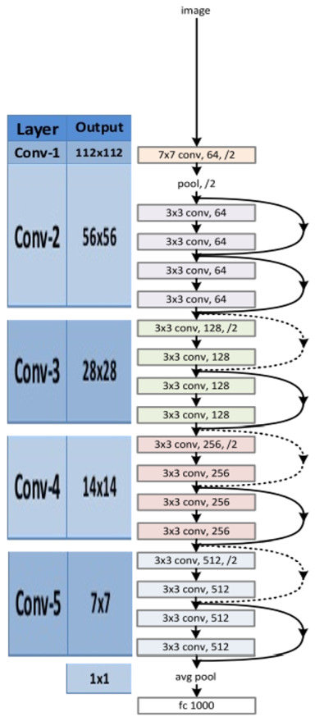
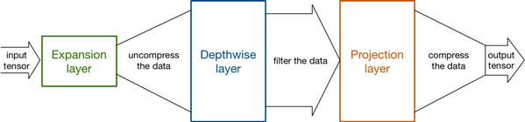
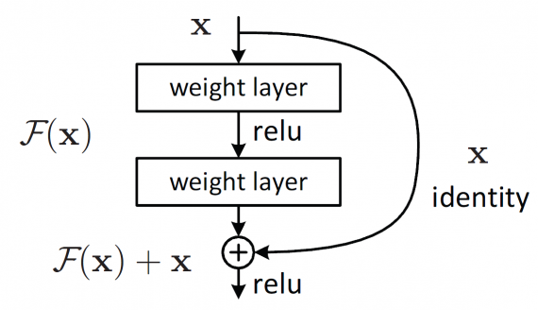
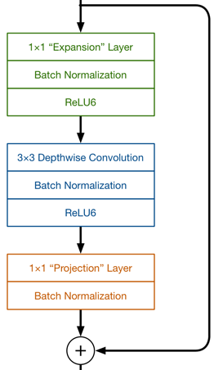
Deep learning models
MobileNetv2
Resnet-18

Slide 16
Classification
Model training and validation accuracy
MobileNetv2 has better accuracy than resnet-18 and requires less space than resnet-18
Cost
MobileNetV2 allows to reduce RAM cost for CPU and provides good latency reducing production cost.
 | Train accuracy | Validation accuracy | Inference time(sec)
Resnet-18 | 0.8648 | 0.9412 | 3.4
Quantized Resnet-18 | 0.9082 | 0.9504 | 2.5
MobileNetV2 | 0.9846 | 0.9917 | 1.3

Slide 17
Image classification
Image dataset(Train and validation)
Image transformation to tensors.
Importing pre trained model in pytorch.
Modifying model for our application.
Result: Type of defect or OK image
Video frames
Edge detection
Image morphing
Contour detection
Contour extraction
Masked image
Bitwise operation
Template matching
Defect image
Image dataset
Classification
Image transformation
Pre-trained model
Fine tuning
Test image transformation

Slide 18
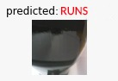
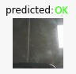
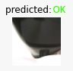
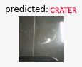
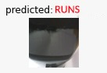
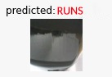
Results
Predictions obtained have 100% accuracy.

Slide 19
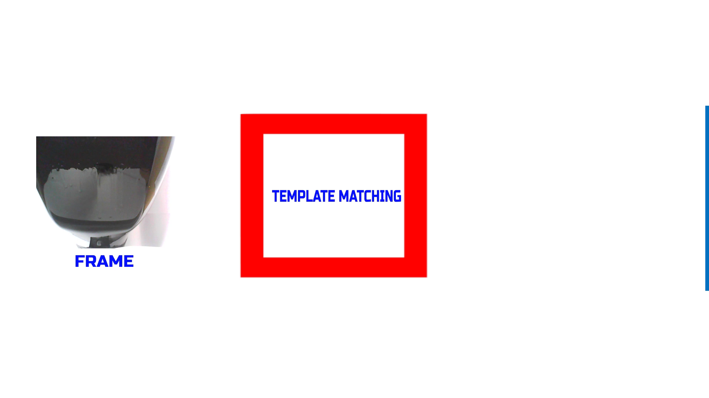

Slide 20
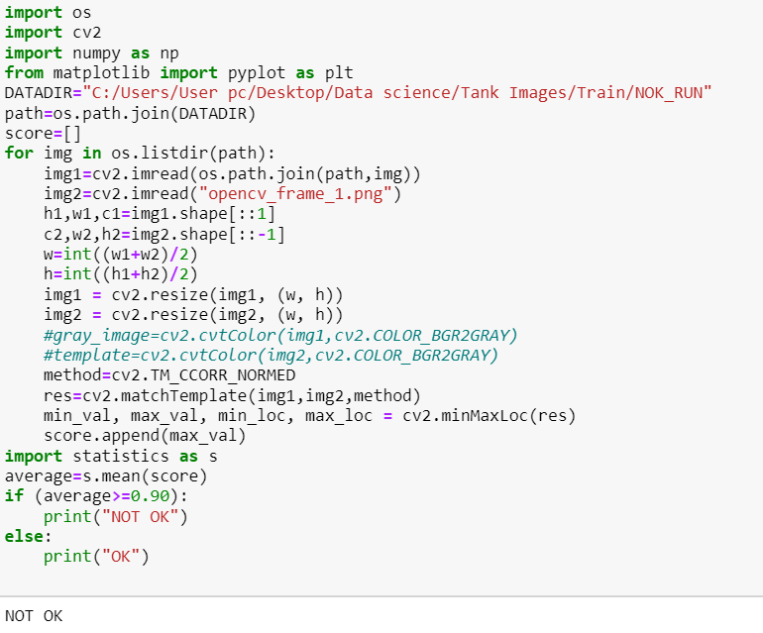
Defect detection

Slide 21
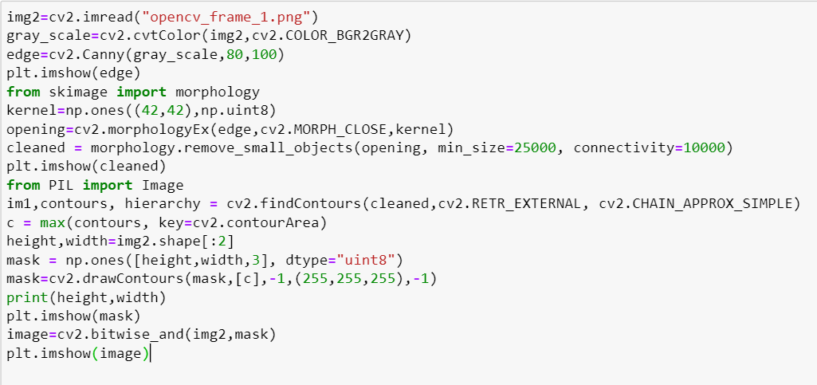
Image Pre processing

Slide 22
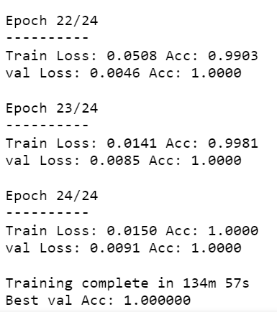
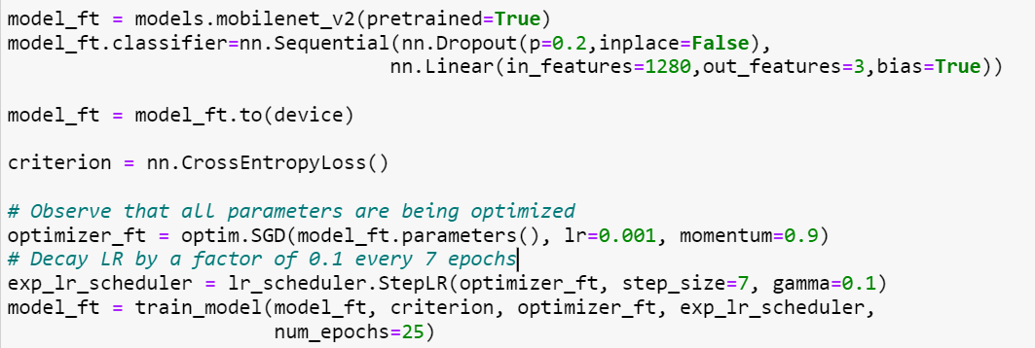
Machine learning model
MobileNetV2

Slide 23
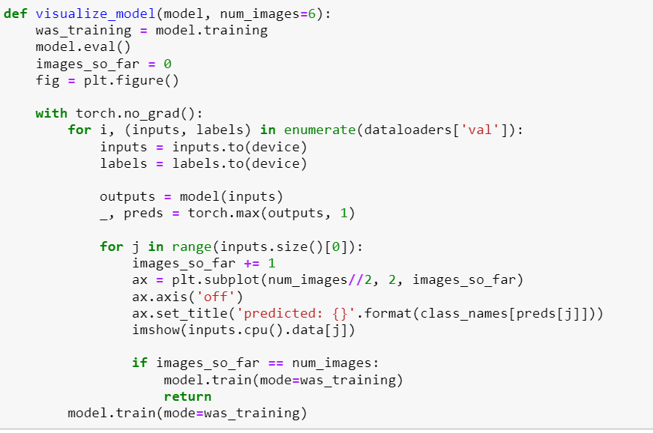
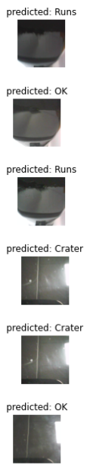
Output

Slide 24
Cost reduction
Solution functions effectively and accurately on defect images and provides low cost real time detection of defects.
Component | Component
Camera | CMOS sensor is chosen against CCD sensor for its low cost. Least possible camera resolution is chosen for application.
Interface | USB 3.0 is the least cost interface for higher bandwidth against camera link, CoaXPress.
Computing | Raspberry pi and Nvidia Jetson Nano have less cost than standard PC systems.
Artificial Intelligence & Machine learning | All codes and algorithms have been self developed. ML model of low size is chosen to reduce RAM size.
Software | Open source software is used for model development.

Slide 25
Thank You!

